Slide 1
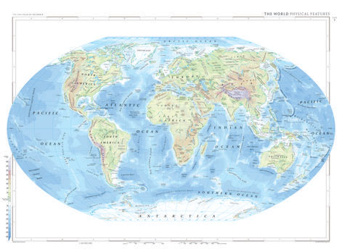
What is Geography?
Geography is the study of the earth’s landforms, peoples, places and environments.

Slide 2
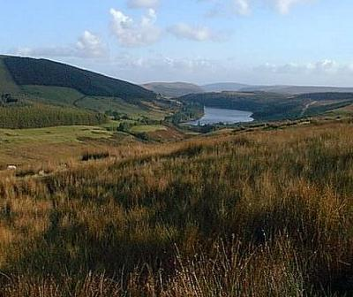
Major Landforms
Valleys: a hollow or surface depression of the earth bounded by hills or mountains, a natural trough in the earth's surface, that slopes down to a stream, lake or the ocean, formed by water and/or ice erosion. At the bottom of a valley is fertile soil, which makes for good farmland.
Plateaus: a large highland area of fairly level land separated from surrounding land by steep slopes. Subject to erosion…but some low plateaus can be good for farming.
Mountains: created by tremendous forces in the earth with a steep top usually shaped up to a peak or ridge

Slide 3
Major Landforms
Plains: are broad, nearly level stretches of land that have no great changes in elevation.
Hills: elevations of the earth's surface that have distinct summits, but are lower in elevation than mountains
Loess: a geologically recent deposit of silt or material which is usually yellowish or brown in color and consisting of tiny mineral particles brought by wind to the places where they now lie. A type of silt which forms fertile topsoil in some parts of the world.
Glaciers: largest component of perennial ice on this planet. Over 75% of the world's fresh water is presently locked up in these frozen reservoirs.

Slide 4
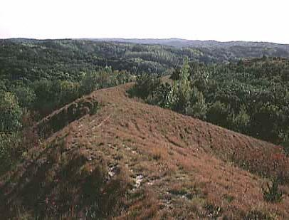
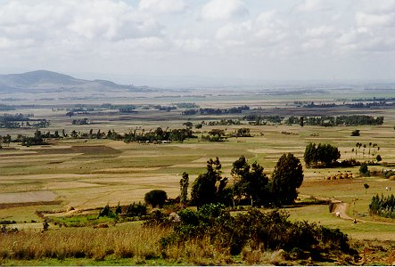
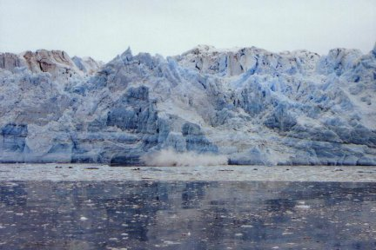
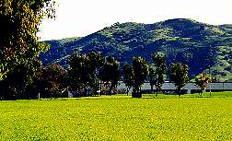
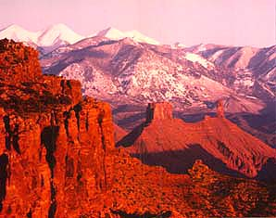

Slide 5
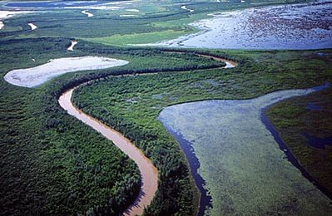
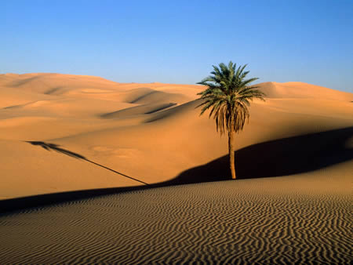
Physical Features
Other physical features may include…
rivers
Lakes
Forests
Deserts

Slide 6
World Climates

Slide 9
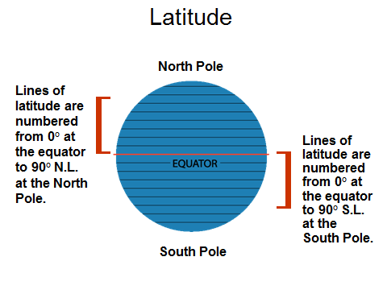
The equator is at 0° latitude. It is neither north nor south. It is at the center between north and south.

Slide 11
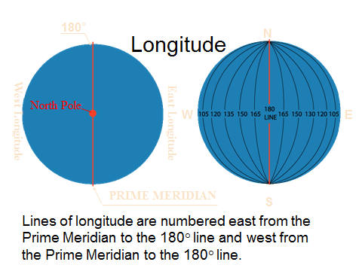

Slide 12
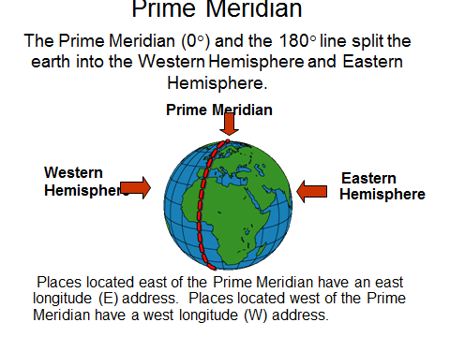

Slide 13
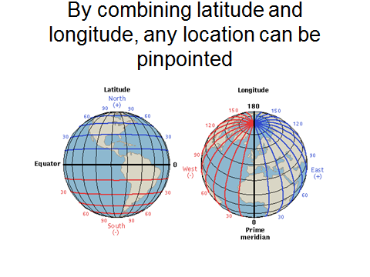

Slide 14
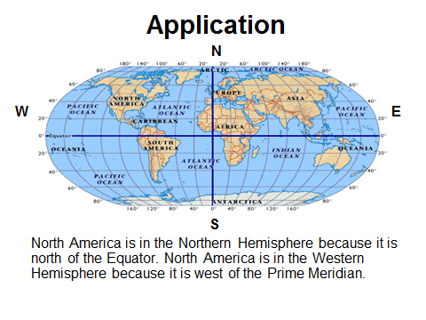

Slide 15
